Slide 1
DBEst: Revisiting Approximate Query Processing Engines with Machine Learning Models
颜超一
数据管理和系统实现

Slide 2
两个问题
问题1： DBEst为什么不选用直方图作为密度估计？
问题2：针对组数较多的GROUP BY查询，DBEst怎样做出的改进

Slide 3
目录
问题引入
目前的解决方案
系统概述
具体实现
实验结果
总结与不足

Slide 4
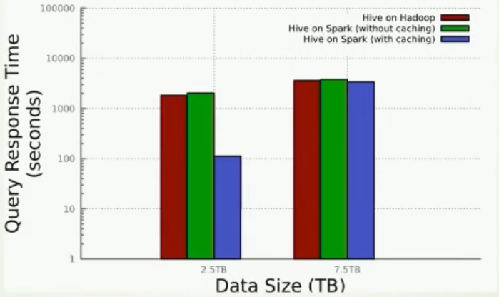
Introduction
In the era of big data, exact analytical query processing is too "expensive".
Notes:
在大数据时代，进行精确分析查询处理的代价是非常昂贵的。

Slide 5
Current solutions
Online aggregation
Data sketches
Sample-based Approaches(the dominating approach)
Limited supported aggregate functions
Still very time-consuming
Space Overhead – samples can be very large
Support for join
Support for nesting
Uniform Sampling
Stratified Sampling
Hash Sampling
The state of the art(verdict DB, QuickR, BlinkDB) use some all three types
Notes:
data sketches是雅虎开源的超快速计算算法。
如果采样的间隔相等，这种采样称为均匀采样。
分层抽样法是从一个可以分成不同子总体（或称为层）的总体中，按规定的比例从不同层中随机抽取样品（个体）的方法。

Slide 6
Offline vs online sampling
 | Offline | Online
Assumption | (partially)known workload | No assumption
Speed up | High | Low
It is generally accepted that both are complementary/helpful:
offline sampling is used for (partially) predictable workloads,
Online sampling is for the rest
Notes:
预先知道常用的查询模板，包括例如范围谓词的属性、连接的表和连接键、一起使用的分组属性。
为选定的表和列的集合创建离线样本，保存在内存中，并处理对所述样本的查询。
依赖在线采样的技术，在查询执行期间动态创建样本，并使用它们来近似答案。

Slide 7
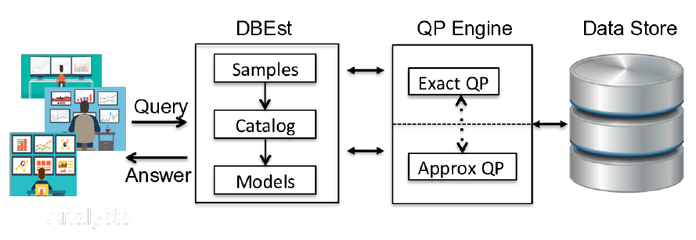
DBEst Architecture
The sampling module: interacts with the storage layer to build samples;
The models module: consists of density estimators and regression models, which are built from the samples
The model catalog: stores information for the available models
Notes:
当一个查询到达时，DBEst读取模型目录，检查是否有可以回答该查询的模型。
如果有，特定的模型将被用于处理查询。如果没有，查询将被发送到其下一级的底层系统，如架构所示。
这可以是另一个AQP引擎（例如，具有在线采样功能的引擎，QuickR），也可以直接进入一个精确答案QP引擎。

Slide 8
DBEst and ML models
What models?
Regression y=R(x)
XGBoost,Gboost,…
Different models works better for different data regions.
Kernel Density
nearest neighbor method
orthogonal series estimators
Density Estimator D(x)
Why not choose Histograms?
Because their discrete nature is at odds with the continuous-function view employed within DBEst.
Notes:
根据是否涉及回归模型进行近似预测，支持的聚合函数分为两类：基于密度的和基于回归的。
回归模型：首先，对每个模型分别进行训练。随后，使用自变量属性域上的随机查询来评估这些模型中的性能好坏。
直方图的问题：
直方图装箱的过程会导致信息丢失；直方图不是唯一的。对比起来比较困难；直方图不是平滑的；直方图不能很好的处理极值

Slide 9
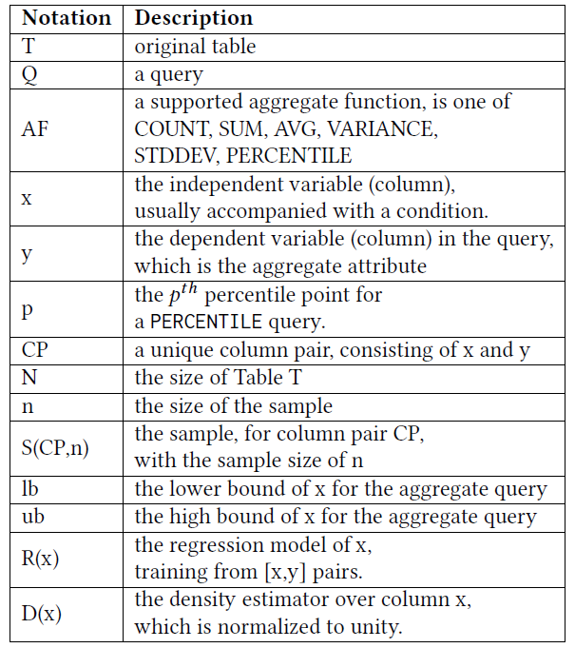
Notation

Slide 10
Introduction
A large class of analytical queries takes the form:
SELECT AF ( y ) FROM Table1,Table2,…
WHERE x BETWEEN lb AND ub
GROUP BY z1,z2,z3
Aggregation functions，such as SUM、AVG、COUNT、PERCENTILE、VARIANCE
selection operators
Notes:
分析查询的大致格式如下：
选择运算符(如范围谓词)有助于关注特定的数据区域

Slide 11
Regression-based and density-based
Density-based
SELECT VARIANCE ( x ) FROM T
WHERE x BETWEEN lb AND ub ;
Regression-based
SELECT VARIANCE ( y ) FROM T
WHERE x BETWEEN lb AND ub ;
Notes:
基于密度的查询中只涉及(列)x，
基于回归的查询既有自变量又有因变量的

Slide 12

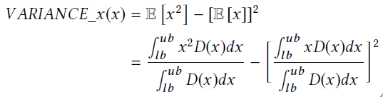


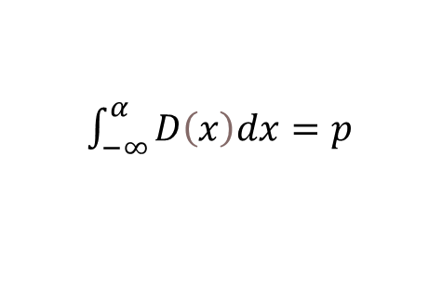


Computing Aggregates with Density Estimators
COUNT.
VARIANCE and STDDEV.
PERCENTILE.
$$P(x < α) = p$$
$\int_{−∞}^{α}{D\left(x\right)dx}=p$
$$F\left(x\right)=p$$
$$α=F^{−1}(p)$$
Notes:
对于F^(-1) (p)，通常没有理论解，而DBEst采用的更实际的解决方案是通过迭代过程找到方程 F(x)=p 的解，这就是求根的朴素二分法。

Slide 13
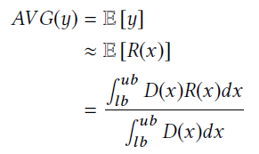
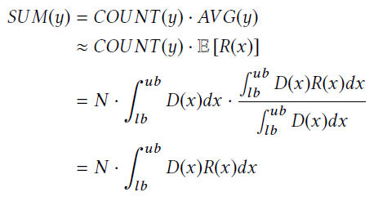
Computing Aggregates with Regression Models
AVG
SUM
Notes:
用回归函数R(x)去近似y

Slide 14
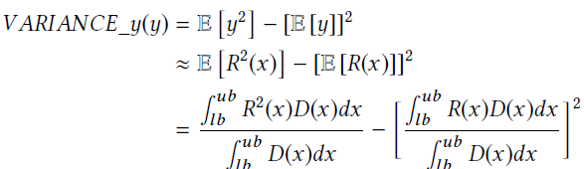
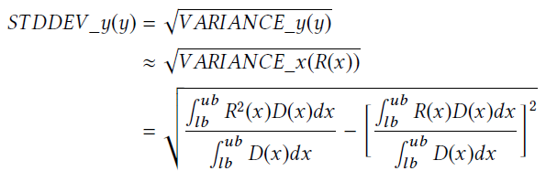
Computing Aggregates with Regression Models
VARIANCE and STDDEV.
Notes:
y的方差等于E[y^2 ]-(E[y] )^2。用R(x)代替y，给出VARIANCE(y)的近似值。

Slide 15
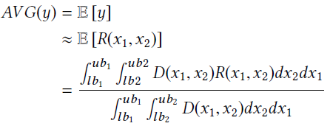
More support on SQL
Multivariate selection
SELECT AVG( y ) FROM T
WHERE x1 BETWEEN lb1 AND ub1
AND x2 BETWEEN lb2 AND ub2 ;
Supporting GROUP BY
build models for each group by value
If there are too many groups:
create model bundles:
E.g. each bundle stores ~500 groups
Store bundles in, say, an SSD (~ 100 ms to deserialize and compute AF on bundle).
Notes:
多变量选择

Slide 16
More support on SQL
Supporting for join
Join table is computed → sampled → models.
Supporting for parallel/Distributed Computation
First, sampling is easily parallelizable
Secondly, model training can be performed in parallel.
Thirdly, query processing can easily be parallel.
Notes:
首先，采样很容易并行化，因为存储数据集分区的不同节点可以独立参与采样过程。
其次，模型训练可以并行进行。例如，对于支持GROUP BY查询的模型，每个组的样本是独立分布的，模型训练可以并行进行。
第三，查询处理很容易并行。或者，DBEst查询执行可以保持顺序，系统中的其他节点/内核可以用来处理其他查询，从而显著提高系统吞吐量。

Slide 17
Experimental Setup
Ubuntu 18.04 with Xenon X5650 12-core CPU, 64 GB RAM And 4TB SSD
Datasets: TPC-DS, Combined Cycle Power Plant (CCPP), Beijing PM2.5
Query types:
Synthetic queries: 0.1%, 1%, to 10% query range
Number of queries: vary between 30 to 1000 queries.
Complex TPC-DS queries: Query 5, 7, and 77.
Compare
against VerdictDB, BlinkDB and MonetDB, for error
against VerdictDB for time
VerdictDB uses 12 cores while DBEst runs on 1 core. (Multi-threaded DBEst is also evaluated)
We show not just query execution times, but also system throughput for the parallel version.
We show the performance of joins and group by.

Slide 18
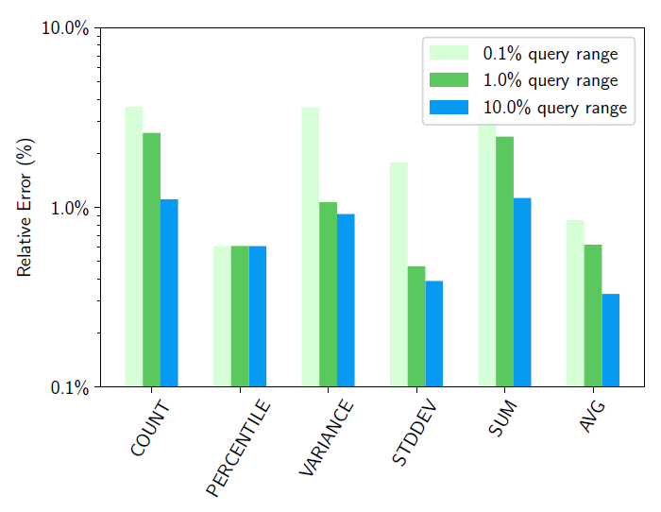
Sensitivity Analysis - Query Range
Dataset: TPC-DS
Table: store-sales
Sample size: 100k rows
540 synthetic queries
Column pair:
[ss_list_price,
ss_wholesale_cost]
Influence of query range on relative error
Notes:
查询范围指的是自变量x的范围
随着范围的增大，可以看到所有聚合函数的误差都在减小。这是预料之中的，因为较小的样本很难找到足够多的有代表性的数据。
可以看到相对误差均在10%之内，这是可以接受的

Slide 19
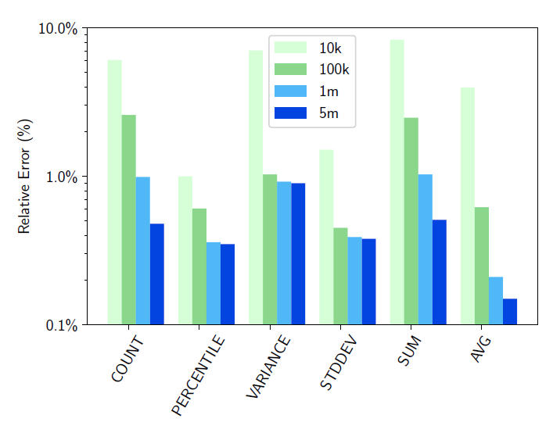
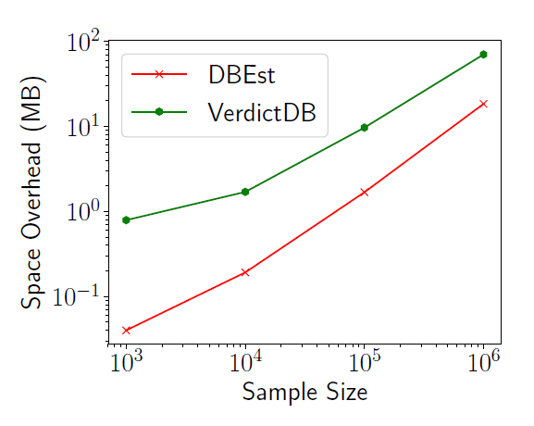
Sensitivity Analysis - Sample size effect
Dataset: TPC-DS Query range: 1% 1200 synthetic queries
Column pair:[ss_list_price,ss_wholesale_cost]
Influence of sample size on relative error
Influence of sample size on space overhead
Notes:
无论样本大小如何，相对误差小于10%，随着样本大小的增加，相对误差显著下降，当样本有100万条记录时，相对误差降至1%以下。
DBEst只需要维护模型，而不需要维护查询执行的样本。DBEst的空间开销比VerdictDB小1到2个数量级。

Slide 20
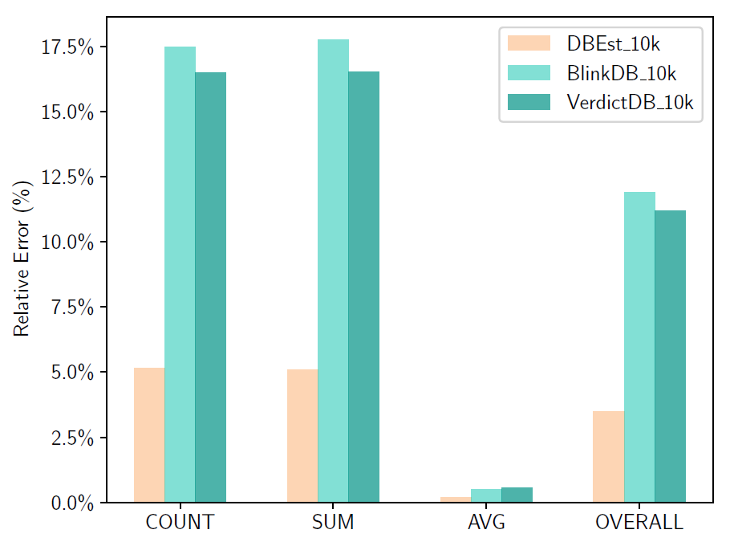
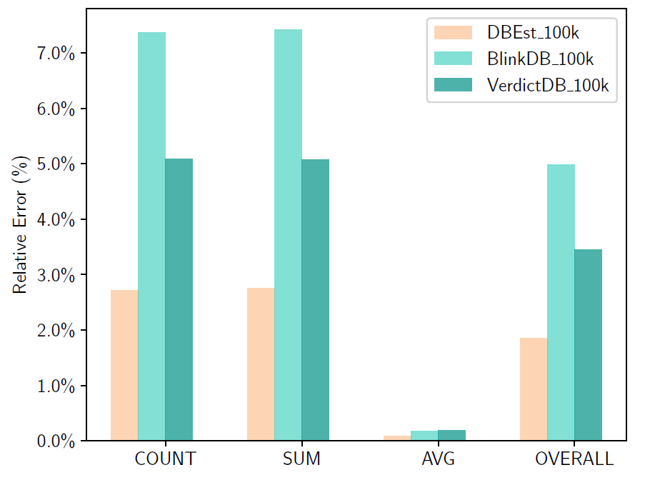
Performance Comparison on CCPP dataset
2.6 billion records, 1.4TB Query range: 0.1%, 0.5%,1%
108 queries, involving 3 column pairs. Sample size: 10k, 100k
Relative error (10k sample)
Relative error (100k sample)
Notes:
DBEst的总体误差为3.5%，而对于其他QP引擎来说，10k样本的相应误差超过10%（尤其是COUNT和SUM）。
对于10万个样本，DBEst的误差降到了1.9%，而VerdictDB的误差降到了3.5%。BlinkDB的准确性比VerdictDB差。
这个实验证明了DBEst系统的泛化能力强，即使在数量级较小的样本上，也能确保准确性

Slide 21
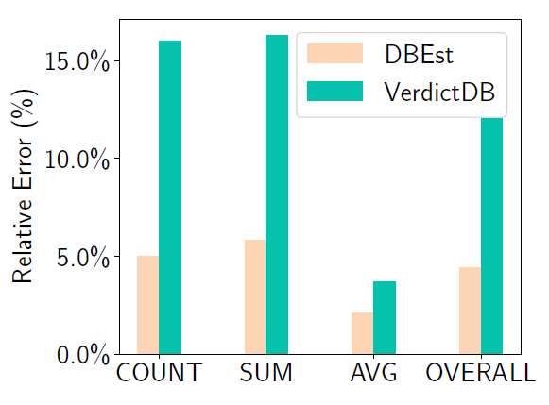
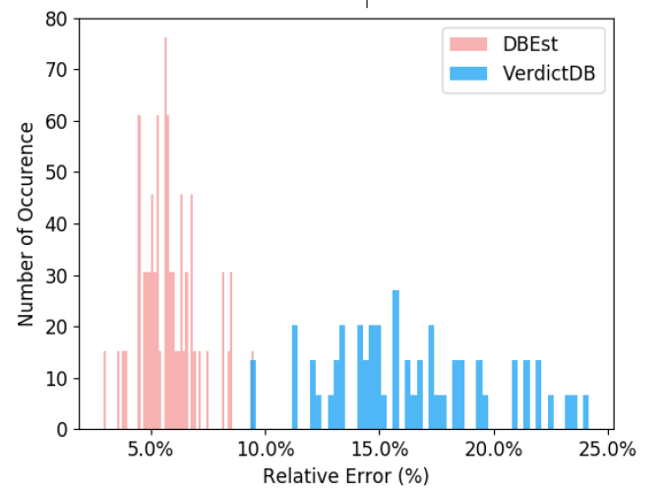
Performance Comparison on Group By
SELECT AF(ss_list_price) FROM store_ sales
WHERE ss_wholesale_cost sk ...
GROUP BY ss_store_sk
90 queries, 57 groups
Sample size: 10k
Relative error for group by queries
Accuracy histogram for SUM
Notes:
对于COUNT和SUM，DBEst的表现明显优于VerdictDB。对于AVG，两者的相对误差相近，均小于3%，DBEst表现略好。
DBEst中SUM查询的平均误差为5.84%，VerdictDB为16.32%。
在57组中，超过80%的DBEst的相对误差小于7.0%。对于 VerdictDB，最小相对误差在10%左右。

Slide 22
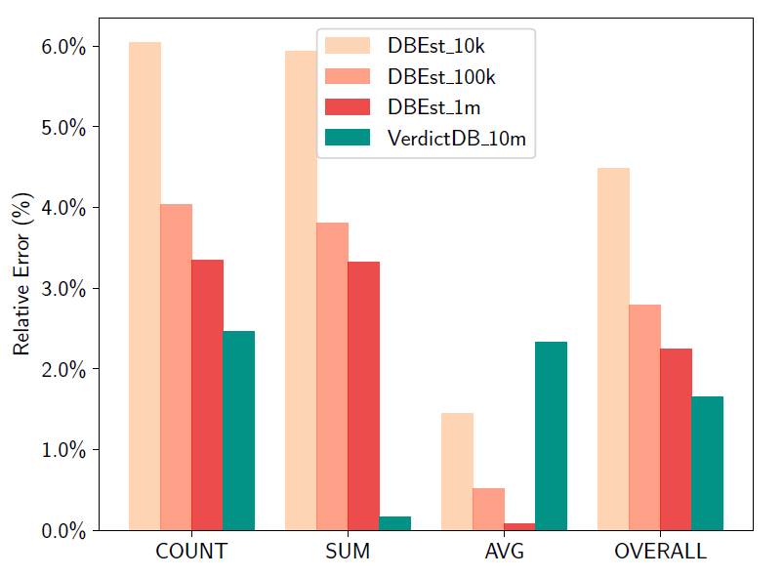
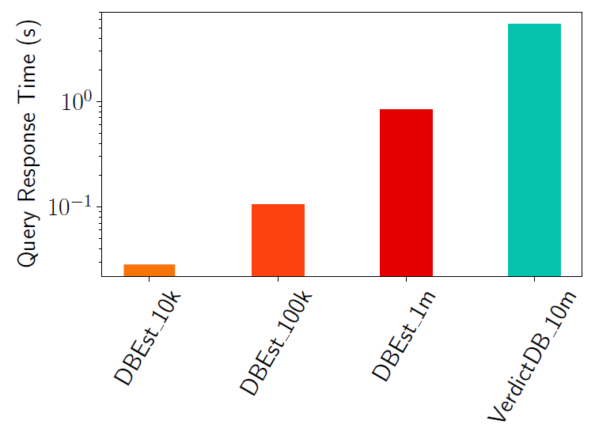
Performance Comparison on Join
SELECT AF(ss_wholesale_cost), AF(ss_net_profit)
FROM store_sales,store
WHERE ss_store_sk = s_store_sk
AND s_number_of_employees BETWEEN ..
42 queries
Join accuracy comparison for the TPC-DS dataset
Query response time (s) for the TPC-DS dataset
Notes:
整体DBEst的误差为4.48%（10k样本）和2.24%（1m样本）。由于 VerdictDB 使用了非常大的 10m 样本，所以误差略好（1.66%）。
对于10k样本，DBEst只需要0.028s，对于1m样本，它需要0.82s，VerdictDB，需要6.7s，总的来说，DBEst实现了8倍到>200倍的速度提升

Slide 23
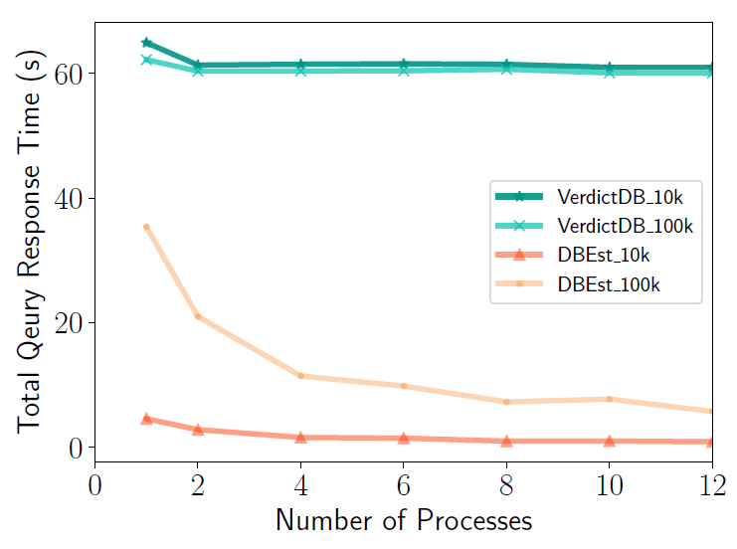
Parallel Query Execution for Group By
1 core versus 12 cores
Throughput of parallel execution (CCPP)
Notes:
对于DBEst，随着使用的内核数越多，时间越短。在使用12个核时，100k（10k）个样本的总时间从35.4s下降到5.78s（从4.6到0.9）。
然而，对于 VerdictDB，由于每个查询都使用了所有的内核，所以总的查询处理时间仍然没有受到影响。

Slide 24
Limitations
Group By Support: as the number of groups increases
Model Training time↑, Query Response time↑, space overhead↑
No error guarantee
Notes:
不提供先验误差保证

Slide 25
Conclusion
Presented DBEst: a model-based AQP engine, using simple SML models:
Regression-based and density-based
Much smaller query response times
High(er) accuracy
Much smaller space-time overheads
Scalability
Ensuring high accuracy, efficiency, scalability with low money investments
resource (cpu, memory/storage/ network) usage.

